Slide 1

News Summarization
Sakshi Kherdekar (36148)
Sakshi Kakde (36157)

Slide 2
Agenda
Introduction to Problem
Introduction
Need and purpose of project
Literature Review
How news summarization works
Types of Summarization
Project Design
Alternate Design
Problem Statement
Scope of the design
Performance Analysis
Final Design

Slide 3

INTRODUCTION TO PROBLEM

Slide 4
INTRODUCTION
News Summarization comes under Unsupervised Machine Learning.
Unsupervised learning is a type of machine learning in which models are trained using unlabeled dataset and are allowed to act on that data without any supervision.
News Summarization is the problem of creating a short, accurate, and fluent summary of a long text document.
Automatic news summarization is the process of creating a short and coherent version of a longer document.
The idea of automatic summarization work is to develop techniques by which a machine can generate summarize that successfully imitate summaries generated by human beings

Slide 5
Need and purpose of the project
Automatic News summarization methods are greatly needed to address the ever-growing amount of text data available online to both better help discover relevant information ,faster.
We cannot possibly create summaries of all the text manually
News Summarization reduce reading time.
Automatic Summarization algorithm are less biased than human summarizers.

Slide 6

Literature review

Slide 7
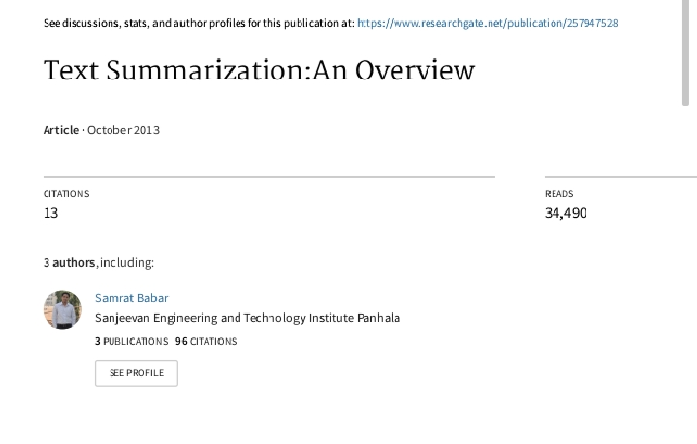
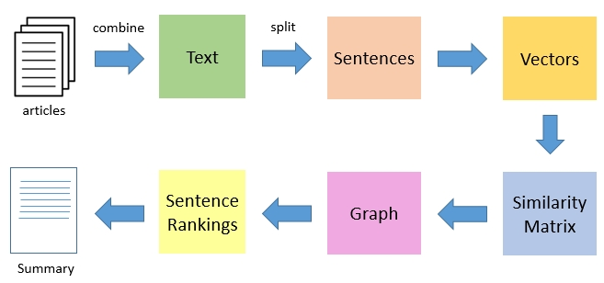
In this Research Paper “ Text- Summarization : An Overview “ Different methods of text summarization are explained, how it works and why it is needed is also explained in this research paper.

Slide 8

How news summarization works

Slide 9
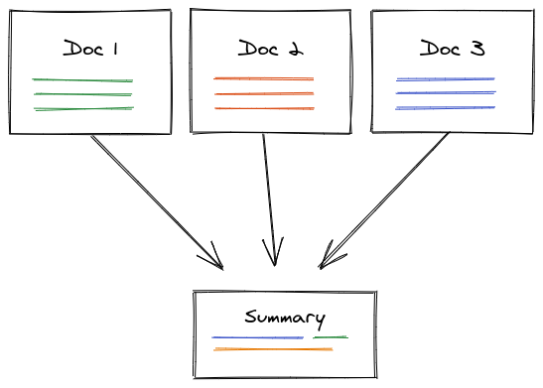
Obtain Data
Text Preprocessing
Convert paragraphs to sentences
Tokenizing the sentences
Find weighted frequency of occurrence
Replace words by weighted frequency in sentences
Sort sentences in descending order of weights
Summarizing the News

Slide 10
Types Of Summarization
Extractive Summarization: These methods rely on extracting several parts, such as phrases and sentences, from a piece of text and stack them together to create a summary. Therefore, identifying the right sentences for summarization is of utmost importance in an extractive method.
Abstractive Summarization: These methods use advanced NLP techniques to generate an entirely new summary. Some parts of this summary may not even appear in the original text.

Slide 11

Project design

Slide 12
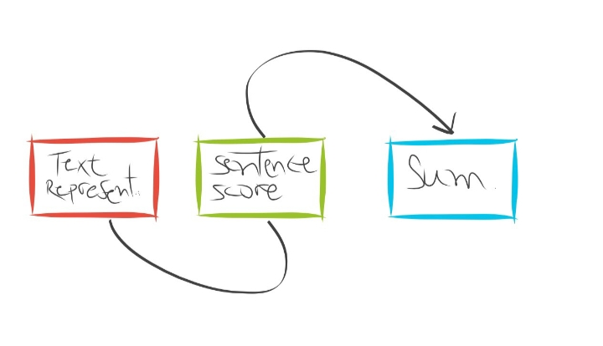
Main Design – News Summarization using NLP
Abstractive summarization methods aim at producing summary by interpreting the text using advanced natural language techniques in order to generate a new shorter text — parts of which may not appear as part of the original document, that conveys the most critical information from the original text, requiring rephrasing sentences and incorporating information from full text to generate summaries such as a human-written abstract usually does. In fact, an acceptable abstractive summary covers core information in the input and is linguistically fluent.

Slide 13
A typical flow of extractive summarization systems consists of:
1. Constructs an intermediate representation of the input text intending to find salient content. Typically, it works by computing TF metrics for each sentence in the given matrix.
2. Scores the sentences based on the representation, assigning a value to each sentence denoting the probability with which it will get picked up in the summary.
3. Produces a summary based on the top k most important sentences. Some studies have used Latent semantic analysis (LSA) to identify semantically important sentences.

Slide 14

alternate design

Slide 15
LSA (Latent Semantic Analysis) - It is a unsupervised learning algorithm that can be used for extracting news summarization. It extracts semantically significant sentences by applying singular value decomposition to the matrix of term – document frequency.
Sumy (Sumy Library) Algorithm is there for News Summarization – Just import Sumy Library
Summarization with Lex Rank- The approach of Lex Rank is that a particular sentence is recommended by other similar sentences and hence is ranked higher.

Slide 16

Web Design
Input : News / Text
Output : Summary / Short Text

Slide 17
DATASET
News | Summary
The State government has stopped sending samples for Omicron confirmation to the National Institute of Virology (NIV), as the infection was mild and patients were getting discharged even before the report was received, said Health Minister Ma. Subramanian. Speaking to media persons on Tuesday, Mr. Subramanian said samples from cluster areas only will be sent for testing to NIV, so that new variants, if any, could be identified.“ The Chief Minister is determined to control the spread of COVID-19 without causing any adverse impact on the economy. So there is no need for a major lockdown. With the cooperation of residents, the number of cases can be controlled. We are also planning to postpone the lockdown this Sunday because of Pongal. Government employees need a break during January 14-16,” said Mr. Subramanian. | Government employees need a break during January 14-16,” said Mr. Subramanian. With the cooperation of residents, the number of cases can be controlled. “ The Chief Minister is determined to control the spread of COVID-19 without causing any adverse impact on the economy. So there is no need for a major lockdown. We are also planning to postpone the lockdown this Sunday because of Pongal. Subramanian.

Slide 18

Problem statement

Slide 19
Preparing A Web application and a ML Model which will Summarize the news using NLP(Natural Language Processing) Machine Learning Approach model using Python Programming language in which the Web Page will be integrated with our News Summarization ML Model. The Web page will contain a text box, in which the user will input the long news and after clicking the summarize button it will display the Summarized news.

Slide 20

Scope Of This Project
This Application can be used by any age group people.
Long Block of news will get summarized in this project.

Slide 21

Performance analysis

Slide 22
NEWS | NLP SUMMARY | ALTERNATE DESIGN SUMMARY
The State government has stopped sending samples for Omicron confirmation to the National Institute of Virology (NIV), as the infection was mild and patients were getting discharged even before the report was received, said Health Minister Ma. Subramanian. Speaking to media persons on Tuesday, Mr. Subramanian said samples from cluster areas only will be sent for testing to NIV, so that new variants, if any, could be identified.“ The Chief Minister is determined to control the spread of COVID-19 without causing any adverse impact on the economy. So there is no need for a major lockdown. With the cooperation of residents, the number of cases can be controlled. We are also planning to postpone the lockdown this Sunday because of Pongal. Government employees need a break during January 14-16,” said Mr. Subramanian. | Government employees need a break during January 14-16,” said Mr. Subramanian. With the cooperation of residents, the number of cases can be controlled. “ The Chief Minister is determined to control the spread of COVID-19 without causing any adverse impact on the economy. So, there is no need for a major lockdown. We are also planning to postpone the lockdown this Sunday because of Pongal. Subramanian. | Speaking to media persons on Tuesday, Mr. Subramanian said samples from cluster areas only will be sent for testing to NIV, so that new variants, if any, could be identified.“ The Chief Minister is determined to control the spread of COVID-19 without causing any adverse impact on the economy.

Slide 23
NEWS | NLP SUMMARY | ALTERNATE DESIGN SUMMARY
New Delhi: After some decent gains, the cryptocurrency market took a breather as major crypto tokens were trading flat. Trading was light as investors looked for signs that Bitcoin's downward spiral has reached an endpoint and that the largest cryptocurrency by market capitalization is ready to enter a new bull cycle. Barring Solana and Polkadot, all other eight out of the top-10 digital tokens were trading with a positive bias during the early trade on Monday. Cardano, meanwhile, zoomed over 12 per cent to become the fifth largest token by market cap. The global crypto market cap was largely unchanged at $2.07 trillion compared to the last day. However, the total crypto market volume increased by 5 per cent to $64.30 billion. | After some decent gains, the cryptocurrency market took a breather as major crypto tokens were trading flat. Cardano, meanwhile, zoomed over 12 per cent to become the fifth largest token by market cap. However, the total crypto market volume increased by 5 per cent to $64.30 billion. The global crypto market cap was largely unchanged at $2.07 trillion compared to the last day. Barring Solana and Polkadot, all other eight out of the top-10 digital tokens were trading with a positive bias during the early trade on Monday. | New Delhi: After some decent gains, the cryptocurrency market took a breather as major crypto tokens were trading flat.

Slide 24
FINAL DESIGN
News Summarization comes under unsupervised machine learning
We have implemented the project using NLP that is Natural Language Processing ,in NLP we have used spaCy library

Slide 25
FINAL DESIGN
spaCy is a free, open-source library for advanced Natural Language Processing (NLP) in Python.
spaCy is designed specifically for production use and helps you build applications that process and “understand” large volumes of text. It can be used to build information extraction or natural language understanding systems, or to pre-process text for deep learning.
In the documentation, you’ll come across mentions of spaCy’s features and capabilities. Some of them refer to linguistic concepts, while others are related to more general machine learning functionality.

Slide 26
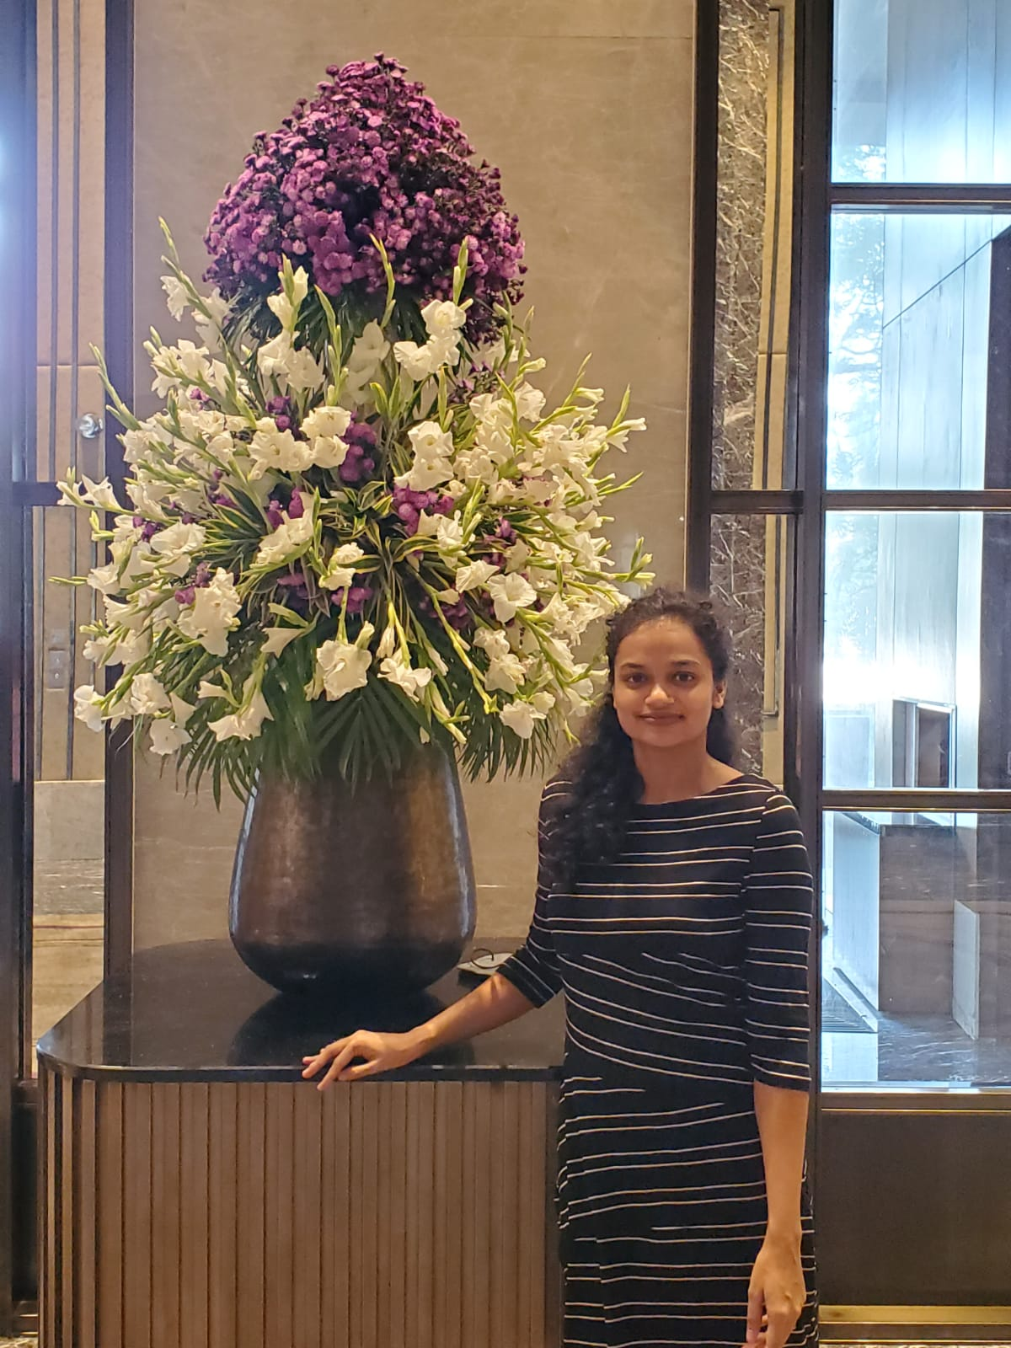
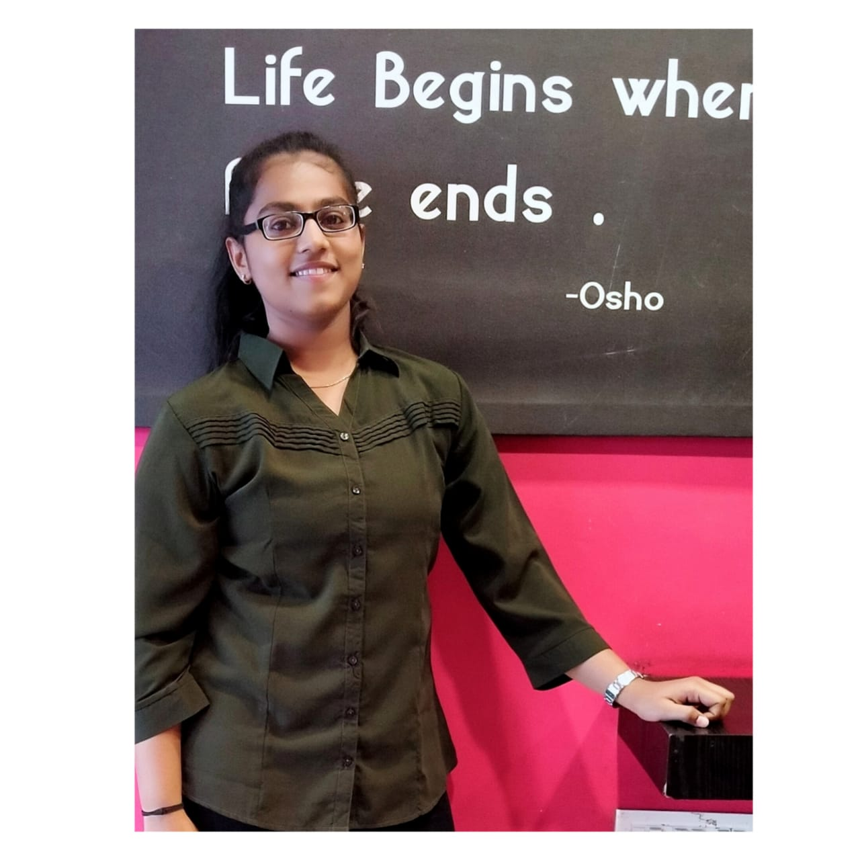
TEAM
Sakshi Kherdekar
Student
Sakshi Kakde
Student

Slide 27


Thank you
Sakshi Kherdekar
sskherdekar2719@gmail.com
Sakshi Kakde
sakshikakde3@gmail.com

